Slide 1
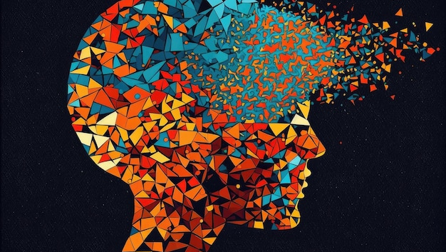
THE FUTURE OF MENTAL HEALTH CARE
AI-Psychiatrie
Where Artificial Intelligence Meets Mental Health Care
Exploring the intersection of technology and healing to transform how we understand, diagnose, and treat mental health conditions

Slide 2
PRESENTATION OVERVIEW
Journey Through AI-Psychiatry
01
The Mental Health Crisis
02
Diagnostic Revolution
Understanding the global challenge and the urgent need for innovative solutions to address the growing burden of mental illness worldwide.
Exploring how AI transforms identification and assessment of mental health conditions through data-driven diagnostics and multimodal analysis.
03
Therapeutic Frontiers
04
Personalization & Ethics
Discovering AI-powered interventions, therapeutic chatbots, digital therapeutics, and personalized treatment approaches at scale.
Examining the path forward through hybrid care models, ethical frameworks, and balancing technological innovation with human connection.
Evidence-Based Research
Clinical Applications
Future Insights

Slide 3

01
The Mental Health Crisis
Understanding the global challenge and the need for innovation

Slide 4
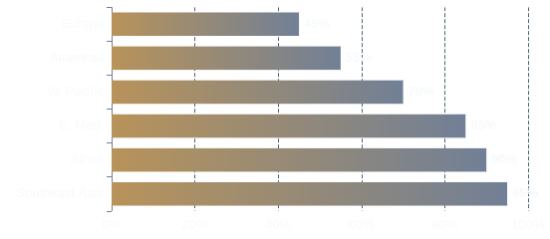
01 • THE MENTAL HEALTH CRISIS
The Global Mental Health Burden
A worldwide public health emergency demanding urgent, scalable solutions
The Staggering Scale
Treatment Gap by Region
In 2023, 44 million people in major markets were diagnosed with Major Depressive Disorder, with millions more undiagnosed.
Additional millions face conditions like schizophrenia (4M) and bipolar disorder (3M), creating an immense treatment challenge.
Critical Provider Shortage
The World Health Organization reports fewer than 1 mental health professional per 100,000 people in many regions.
The Innovation Imperative
Traditional mental healthcare models cannot scale to meet this crisis. AI offers a path to extend care to millions who would otherwise go untreated.
This gap leaves millions without access to timely, evidence-based care, with waitlists often spanning months.
Sources: WHO, Nature, DelveInsight 2023
Mental health prevalence data: 7 Major Markets (7MM)

Slide 5
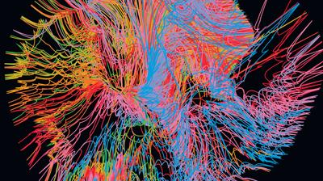
02
Diagnostic Revolution
How AI transforms identification and assessment of mental health conditions

Slide 6
02 • DIAGNOSTIC REVOLUTION
Machine Learning in Psychiatric Diagnosis
Achieving unprecedented accuracy in mental health assessment
The DASS-42 Breakthrough
From Subjective to Objective
Machine learning algorithms analyzing the Depression Anxiety Stress Scales (DASS-42) are achieving extraordinary diagnostic accuracy , surpassing traditional clinical assessments.
Traditional psychiatric diagnosis relies on subjective self-reports and clinician interpretation, introducing potential bias and variability.
99.3%
98.9%
98.8%
AI introduces data-driven objectivity , analyzing patterns in questionnaire responses that may be invisible to human evaluators.
Depression
Anxiety
Stress
This shift enables earlier detection, standardized assessments across populations, and reduced diagnostic errors.
Algorithm Performance Comparison
Support Vector Machines (SVM) consistently outperform other models, followed by Random Forest. Decision Trees and Naïve Bayes show lower accuracy but remain valuable for interpretability.
Clinical Impact
Rapid screening in primary care
Reduced waiting times for specialist referral
Accessible assessment in underserved areas
SVM
99.3%
Random Forest
92.8%
Source: Nature Scientific Reports, 2025 • SVM = Support Vector Machine
DASS-42 Validation Study

Slide 7
02 • DIAGNOSTIC REVOLUTION
Multimodal AI: Seeing the Whole Person
Integrating multiple data streams for comprehensive mental health assessment
Voice Analysis
Digital Phenotyping
Vocal biomarkers detect depression through speech patterns: prosody, tone, pitch variability, and rhythm changes.
Smartphones enable continuous, passive monitoring of behavioral patterns without disrupting daily life.
AI analyzes temporal features to identify clinically significant patterns, achieving 82.5% accuracy in depression detection when combined with other modalities.
By analyzing sleep patterns, social interactions, and movement, AI creates a digital psychological signature for early warning.
Physiological Data
Language & Text
Facial Expressions
Wearables track heart rate variability, sleep cycles, and activity levels to provide objective indicators of mental state.
NLP analyzes linguistic patterns, sentiment, and word choice in messages or social media to detect early signs.
Computer vision detects micro-expressions and gaze patterns during video calls or selfie videos.
The Power of Integration
No single modality captures the full picture. Multimodal fusion combines voice, text, facial, behavioral, and physiological data to create a holistic view that surpasses individual components, mimicking how clinicians synthesize multiple information sources.
Sources: Nature, 2025 • arXiv, 2025
Ellipsis Health: Vocal biomarker technology

Slide 8
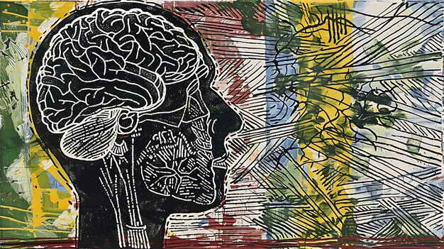
03
Therapeutic Frontiers
AI-powered interventions and treatment modalities

Slide 9
03 • THERAPEUTIC FRONTIERS
AI Chatbots: CBT at Scale
Evidence-based cognitive behavioral therapy accessible 24/7 to anyone, anywhere
W
Woebot
W
Wysa
Y
Youper
48%
1M+
43%
Reduction in depression symptoms among users, supported by multiple randomized controlled trials.
Users supported by 2022 with evidence-based techniques, coaching, and AI-guided conversations.
Reduction in anxiety symptoms through AI-powered emotional tracking and personalized interventions.
Key Features
Specialized Applications
Unique Approach
Conversational CBT interface
Chronic pain management
Emotional state tracking
Mood tracking & insights
Maternal mental health
Multilingual support
Crisis intervention protocols
FDA Breakthrough Device designation
Cultural sensitivity features
WAI-SR score: 3.03 (comparable to human therapists)
Higher engagement = greater mood improvements
Available in 7 languages globally
Why Chatbots Work
They overcome stigma, cost, and access barriers, providing evidence-based CBT techniques and complementing traditional therapy by offering support between sessions.
Sources: PMC, 2024 • WAI-SR = Working Alliance Inventory-Short Revised
CBT = Cognitive Behavioral Therapy

Slide 10
03 • THERAPEUTIC FRONTIERS
Beyond Chatbots: Digital Therapeutics & VR
Advanced AI applications transforming mental health treatment
Digital Therapeutics (DTx)
Virtual Reality Exposure Therapy
FDA-approved software programs that treat medical conditions, including neuropsychiatric disorders, with rigorous clinical validation.
Immersive VR environments allow patients to confront triggers in controlled settings. AI personalifies exposure intensity in real-time.
DTx can be used as monotherapy or adjunctive therapy . Examples include reSET for substance use disorder and EndeavorRx for ADHD.
Oxford VR's programs demonstrate superior effectiveness for conditions like PTSD, phobias, and social anxiety.
Personalized Medication Management
AI in Drug Discovery
AI predicts patient responses to psychiatric medications by analyzing genetic profiles, medical history, and biomarkers.
AI accelerates development of novel psychiatric medications by predicting blood-brain barrier permeability and identifying new drug targets.
Companies like Tempus reduce the trial-and-error approach in prescribing antidepressants, accelerating recovery.
This approach is discovering novel antidepressants and therapies for neuropsychiatric conditions.
Remote Monitoring & Prediction
AI platforms analyze smartphone data to predict mental health decline, enabling timely interventions. Ceccarelli & Mahmoud (2022) achieved 88% accuracy in predicting bipolar disorder symptom exacerbation.
Sources: PMC, 2024 • Nature, 2025 • Oxford VR
DTx = Digital Therapeutics • FDA = Food and Drug Administration

Slide 11
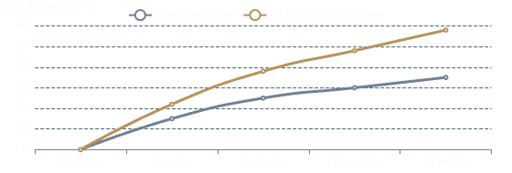
03 • THERAPEUTIC FRONTIERS
Personalized Psychiatry Through AI
Moving from one-size-fits-all to precision mental healthcare
Precision Medicine
Reinforcement Learning
AI creates individualized treatment plans by analyzing a patient's unique characteristics, including genetic profiles and response history.
RL algorithms learn through interaction and feedback, optimizing treatment strategies in real-time.
This approach predicts treatment response , reducing the trial-and-error period and accelerating remission.
In depression treatment, RL selects therapeutic steps based on symptom trajectories. For PTSD, it balances short-term relief with long-term recovery.
Example: AI can identify which patients are likely to respond to SSRIs vs. SNRIs based on genetic markers, avoiding months of ineffective treatment.
Advantage: RL models adapt continuously , refining interventions based on patient response.
Data Sources for Personalization
Clinical Outcomes
Genomics & pharmacogenetics
Neuroimaging & EEG data
Clinical history & symptom trajectories
Lifestyle & environmental factors
Sources: Exploration, 2024 • Nature, 2025
SSRI = Selective Serotonin Reuptake Inhibitor • SNRI = Serotonin-Norepinephrine Reuptake Inhibitor

Slide 12
03 • THERAPEUTIC FRONTIERS
The Engagement Crisis: Challenges & Limitations
The stark reality behind the promise of AI mental health solutions
The Retention Crisis
Clinical Limitations
Despite clinical efficacy, digital mental health apps face mass attrition. A study of 93 apps revealed devastating real-world retention rates.
AI cannot replace human expertise in critical areas. For severe conditions, complex trauma, and crisis intervention, human therapists remain irreplaceable.
95%
3.3%
53%
Where AI Falls Short
Dropout Rate
30-Day Retention
Abandon <7 Days
Severe Mental Illness: Psychosis, mania, or detachment from reality.
Crisis Intervention: Suicide risk assessment and emergency coordination.
Complex Trauma: Careful, responsive guidance for deep emotional wounds.
Why Users Leave
1
Monotonous Design
Generic, non-personalized experiences and tedious processes cause disengagement.
The Evidence Gap
Traditional therapy achieves 45-50% symptom reduction vs. 30-35% for AI therapy , largely due to the irreplaceable human elements of empathy and connection.
2
Cold AI Responses
"Cold and generic" responses lead to disappointment and abandonment.
3
Overreliance on Technology
The therapeutic alliance remains the strongest predictor of positive outcomes—something AI cannot yet replicate.
Insufficient human oversight and a lack of crisis support erode trust.
Sources: ACM Digital Library, 2025 • LinkedIn Research, 2025
UX = User Experience • AI = Artificial Intelligence

Slide 13
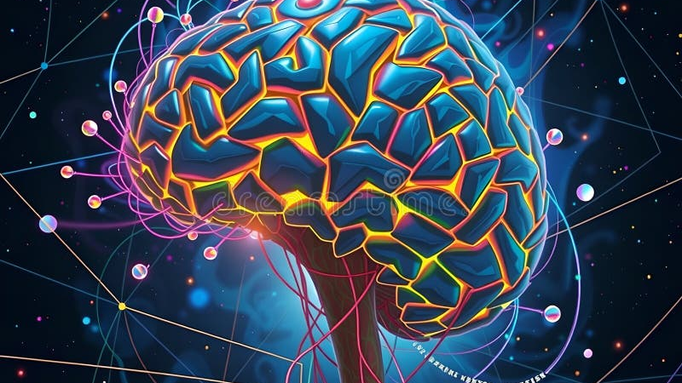
04
Ethics & The Future
Navigating responsibility, privacy, and the path forward

Slide 14
04 • ETHICS & THE FUTURE
Ethical Imperatives in AI-Psychiatry
Building trust through responsible innovation and patient-centered design
Data Privacy & Security
Algorithmic Bias
The BetterHelp Case: In 2023, the FTC settled for $7.8 million after sharing sensitive data for ads.
AI trained on limited datasets may misread or underserve diverse populations, perpetuating healthcare disparities.
Mental health data requires the highest protection standards. Best practices include no storage of identifiable data and transparency about data use.
Developers must use diverse training data and regularly audit for fairness.
Accountability & Liability
Informed Consent & Transparency
When an AI system makes an error, who is held accountable? The developer, clinician, or platform?
Patients have a right to know when they're interacting with AI, including its capabilities, limitations, and data handling.
Clear liability frameworks are needed. Clinician oversight is essential to mitigate risks.
Consent must be clear and transparent , not buried in legal policies.
The Human Connection
AI lacks essential human skills like compassion and shared understanding. The ethics of care approach demands AI be designed and evaluated based on its impact on the therapeutic relationship, not just technical performance.
Sources: JMIR, 2024 • HelpSquad, 2025 • APA, 2025
FTC = Federal Trade Commission • AI = Artificial Intelligence

Slide 15
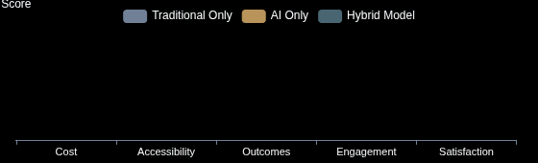
04 • ETHICS & THE FUTURE
The Path Forward: Hybrid Models of Care
Combining AI strengths with human expertise to create sustainable mental healthcare
AI's Strengths
The Hybrid Model Vision
24/7 Availability: Always-on support for daily check-ins.
A collaborative approach where AI augments, not replaces, human clinicians. AI handles routine tasks, data analysis, and continuous support, while therapists focus on complex cases and deep therapeutic work.
Scalability: Reaching millions who lack access.
Consistency: Standardized, evidence-based interventions.
Continuous Monitoring: Passive data collection for early warnings.
Example Workflow
1.
AI daily check-ins & skill reinforcement
2.
Weekly deep-dive sessions with human therapist
3.
AI summary & data insights provided to therapist
4.
Crisis escalation protocols & human oversight
Optimizing Cost & Outcomes
Human Expertise
Complex Case Management: Severe illness and comorbidities.
Crisis Intervention: Suicide risk assessment and emergency response.
Empathy & Connection: Deep emotional attunement and healing.
Clinical Judgment: Nuanced understanding and flexible adaptation.
Sources: HeyNoah, 2025 • Exploration, 2024
AI = Artificial Intelligence • CBT = Cognitive Behavioral Therapy

Slide 16
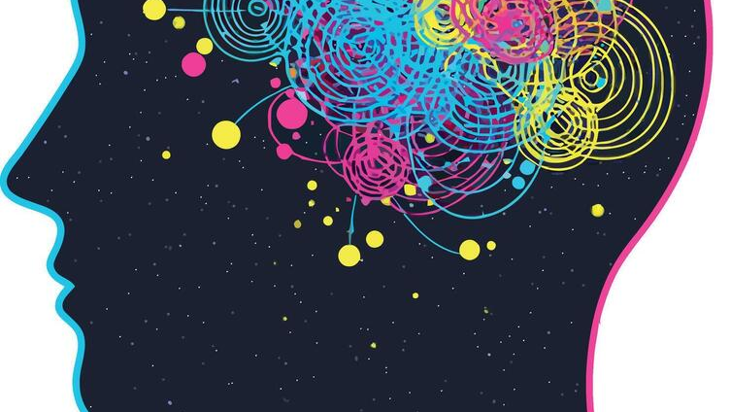
Technology with Empathy
AI in psychiatry is not about replacing human connection—
it's about extending care to those who need it,
when they need it, and how they need it.
The future lies in technology that listens, learns, and collaborates with human wisdom to heal minds and transform lives.
Evidence-Based
Ethically Grounded
Human-Centered

